Slide 1
DCMS
Course Selection Information Session
January 13, 2026

Slide 2
Course Selection
Master schedules change from year to year and are developed in the spring prior to the upcoming year based on courses requested by students.
Very seldom does a single course change affect only one course, therefore there are district deadlines for course selection and verification.
Careful selections in a timely manner benefit everyone!
Please make the time to discuss and plan next year’s courses with your child.

Slide 3
Course Selection Timeline
January 13th, 2026: Course Selection Parent Information Night at 6:30
January 20th, 2026: Course selection sheets distributed to students via their History classes
January 23rd, 2026: Completed Course Selection sheets with a parent signature are due back to your student’s History teacher
  Course Selection sheets MUST be turned in on this date. If not, students will not be able to input their choices in SchooLinks.
  Failure to turn in a course selection sheet may result in your Counselor selecting your classes for the 26-27 school year
January 27 – 29, 2026: Course Selection Input via your student’s History classes
Course Verification Window: March 3rd – 5th in Skyward Family Access
  This will be the final time for parents/students to review your course selection and make changes before the 2026-27 school year.

Slide 4
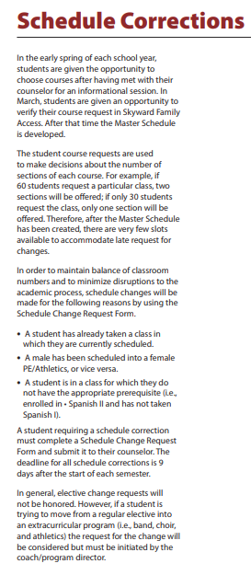
SCHEDULE CORRECTIONS
This school year, schedule corrections were only accepted for the reasons listed below per district protocol. This will be implemented again for the 26-27 school year as well:
A student has already taken a class in which they are currently scheduled (example: Art 1 cannot be taken in 7th grade if you took Art 1 in 6th grade)
A male has been scheduled into a female PE/Athletics, or vice versa.
A student is in a class for which they do not have the appropriate prerequisite (i.e., enrolled in Art II and has not taken Art I).
Level Changes (On-level to AAC or vice versa based on course availability)

Slide 5

Course Verification Window for Parents & Students
March 3 – 5, 2026 in Skyward Family Access
This will be the final time for parents/students to review your course selection and make changes before the 2026-27 school year.
No schedule change requests will be accepted after March 5th.
When school resumes for the 2026-27 school year, only schedule corrections will be made according to the reasons discussed.

Slide 6



7th Grade
Course Selection

Slide 7
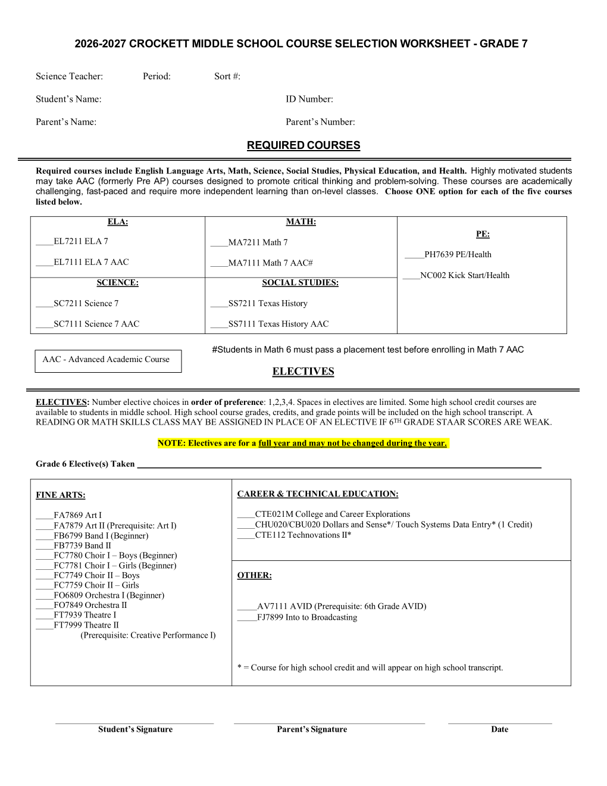

^{7th} Grade Course Selection Form

Slide 8
Required Courses for 7th Grade
English On-Level or AAC
Texas History On-Level or AAC
Math On-Level or AAC
Science On-Level or AAC
1 semester of P.E. - KickStart AND 1 semester of Health
Advisory

Slide 9
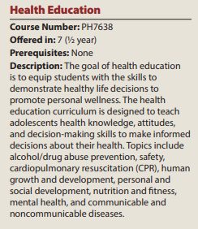
Health
7th grade students are required to take 1 semester of Health.
  Students cannot choose which semester they take Health

Slide 10
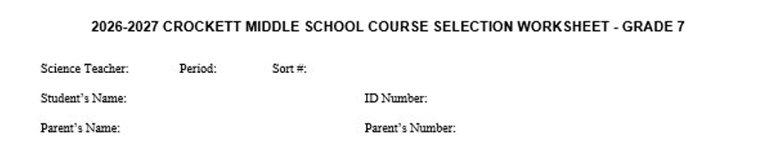
7th Grade Course Selection Form

Slide 11
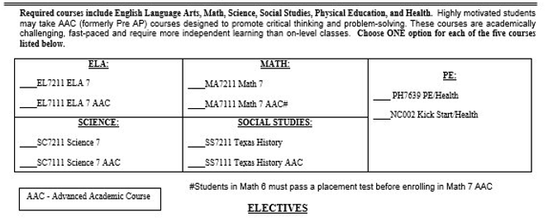
Required Courses

Slide 12
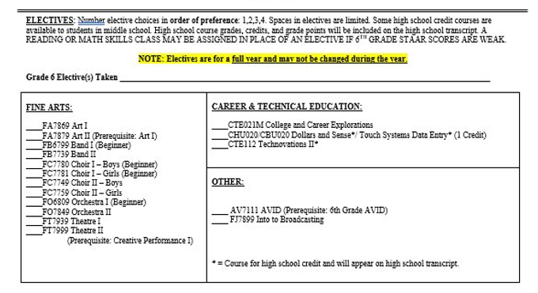
Electives
Number elective choices in order of preference: 1,2,3,4,5

Slide 13
Student and Parent Signatures are required.

Slide 14
Additional Electives

Slide 15
Art
Students explore basic elements of art and principles of design using a variety of media and techniques. Art appreciation and art history are basic to the course. Students work on honing their critical analysis skills and recreating traditional, as well as contemporary, works of art. Students will have the opportunity to participate in competitions. Students may be required to purchase some materials (art kit or supply list). An art fee may be required in some instances. Sketchbooks are required.

Slide 16
Band
Students are taught the proper care and handling of instruments, as well as hand position and proper tone production. Music fundamentals are taught to enable students to recognize and apply musical symbols and terms. Attitudes toward cooperative effort and enthusiastic band spirit are stressed. Winter and/or spring concerts constitute the band’s performance requirements. Students may be required to purchase or rent their own instruments, as well as purchase some instructional materials. (Instruments may be obtained through a rental/purchase agreement.) An annual $80 fee is charged to students selected by the program director to use school-owned instruments. It may be necessary to purchase some materials for uniformity of dress for performance purposes.

Slide 17
Choir
Choral Music provides students with basic training in vocal production, general musicianship, and choral performance. Music fundamentals are taught to enable the student to recognize and apply musical signs, symbols, and terms. Sight-singing skills are taught using Curwen hand signs. Various performance opportunities are available throughout the year. It may be necessary to purchase some materials for uniformity of dress for performance purposes.

Slide 18
Orchestra
Orchestra encourages the development of instrumental musicianship. Leadership, responsibility, cooperation, self- discipline, and concentration are stressed. Orchestra students will be involved in various performances and competitions throughout the year. Placement is by audition only. Students may be required to purchase or rent their own instruments, as well as purchase some instructional materials. (Instruments may be obtained through a rental/purchase agreement.) The school furnishes some instruments, such as cellos, basses, and harps for classroom use. An annual $80 fee is charged to students selected by the program director to use school-owned instruments. It may be necessary to purchase some materials for uniformity of dress for performance purposes.

Slide 19
Theatre
Students are introduced to a variety of performance opportunities and a basic understanding of the theatre. Students learn theatre preparation techniques, discover ways to communicate nonverbally, and enhance control of their voice and body. Students study a range of theatrical content and have opportunities to perform in class and in stage productions.

Slide 20
Intro to Broadcasting
An introduction to basic graphic design elements for digital media, along with video and audio production techniques will be applied to various project-based learning. Students will be introduced to creating, editing, and directing videos for school-wide communications.

Slide 21
7th Grade AVID
  The seventh-grade AVID Elective course builds upon the components of the AVID philosophy. Students will refine goals, work on intra-personal and interpersonal skills, as well as formal and informal speech. Students will complete evaluations related to reading, writing, organization, and speaking, and begin considering audience, purpose, and form in their writing. Students will understand the roles of all members in assignments and collaborative lessons and will expand their knowledge bases of note-taking in relation to studying and test preparation. Students will be exposed to different field trips, guest speakers, and research, to increase their knowledge of college and career options.

Slide 22
College & Career Exploration
  The goal of Career and College Exploration is to help students build career awareness and engage in deep exploration and study of the Texas CTE career clusters to create a foundation for success in high school, possible post secondary studies, and careers. The career development process is unique to every person and evolves throughout one’s life. In Career and College Exploration, students use decision-making and problem-solving skills for individual career and academic planning. Students explore valid, reliable educational and career information to learn more about themselves and their interests and abilities. Students integrate skills from academic subjects, information technology, and interpersonal communication to make informed decisions. This course is designed to guide students through the process of investigating and developing a college and career readiness plan. Students use aptitude and interest inventory assessments, labor market information, software, or other tools available to explore a variety of career paths, especially those in demand. Students will begin mapping their anticipated secondary coursework and potential postsecondary experiences that are in alignment with their Goals.

Slide 23
Electives for High School Credit
**HS credit courses remain on your student’s high school transcript and count toward your student HS Grade Point Average (GPA)**

Slide 24
Technovations II
(1 credit)
This course will dive deeper into more complex and practical robotics applications while introducing aviation and more advanced coding. Students will apply their engineering skills to design and program more advanced robots for real-world scenarios. They will explore the core principles of flight, aerodynamics, and elementary drone design.

Slide 25
Dollars and Sense
(.5 credit)
  Dollars and Sense focuses on consumer practices and responsibilities, money-management processes, decision making skills, and impact of technology. The student demonstrates management of individual and family resources such as finances, food, clothing, shelter, health care, recreation, transportation, time, and human Capital.

Slide 26
Touch Systems Data Entry
(.5 credit)
This course will allow students to develop keyboarding skills and techniques. Students will use software applications to develop and format basic business documents as well as enhance reading, writing, computing, and communication skills applicable to a variety of industries.

Slide 27

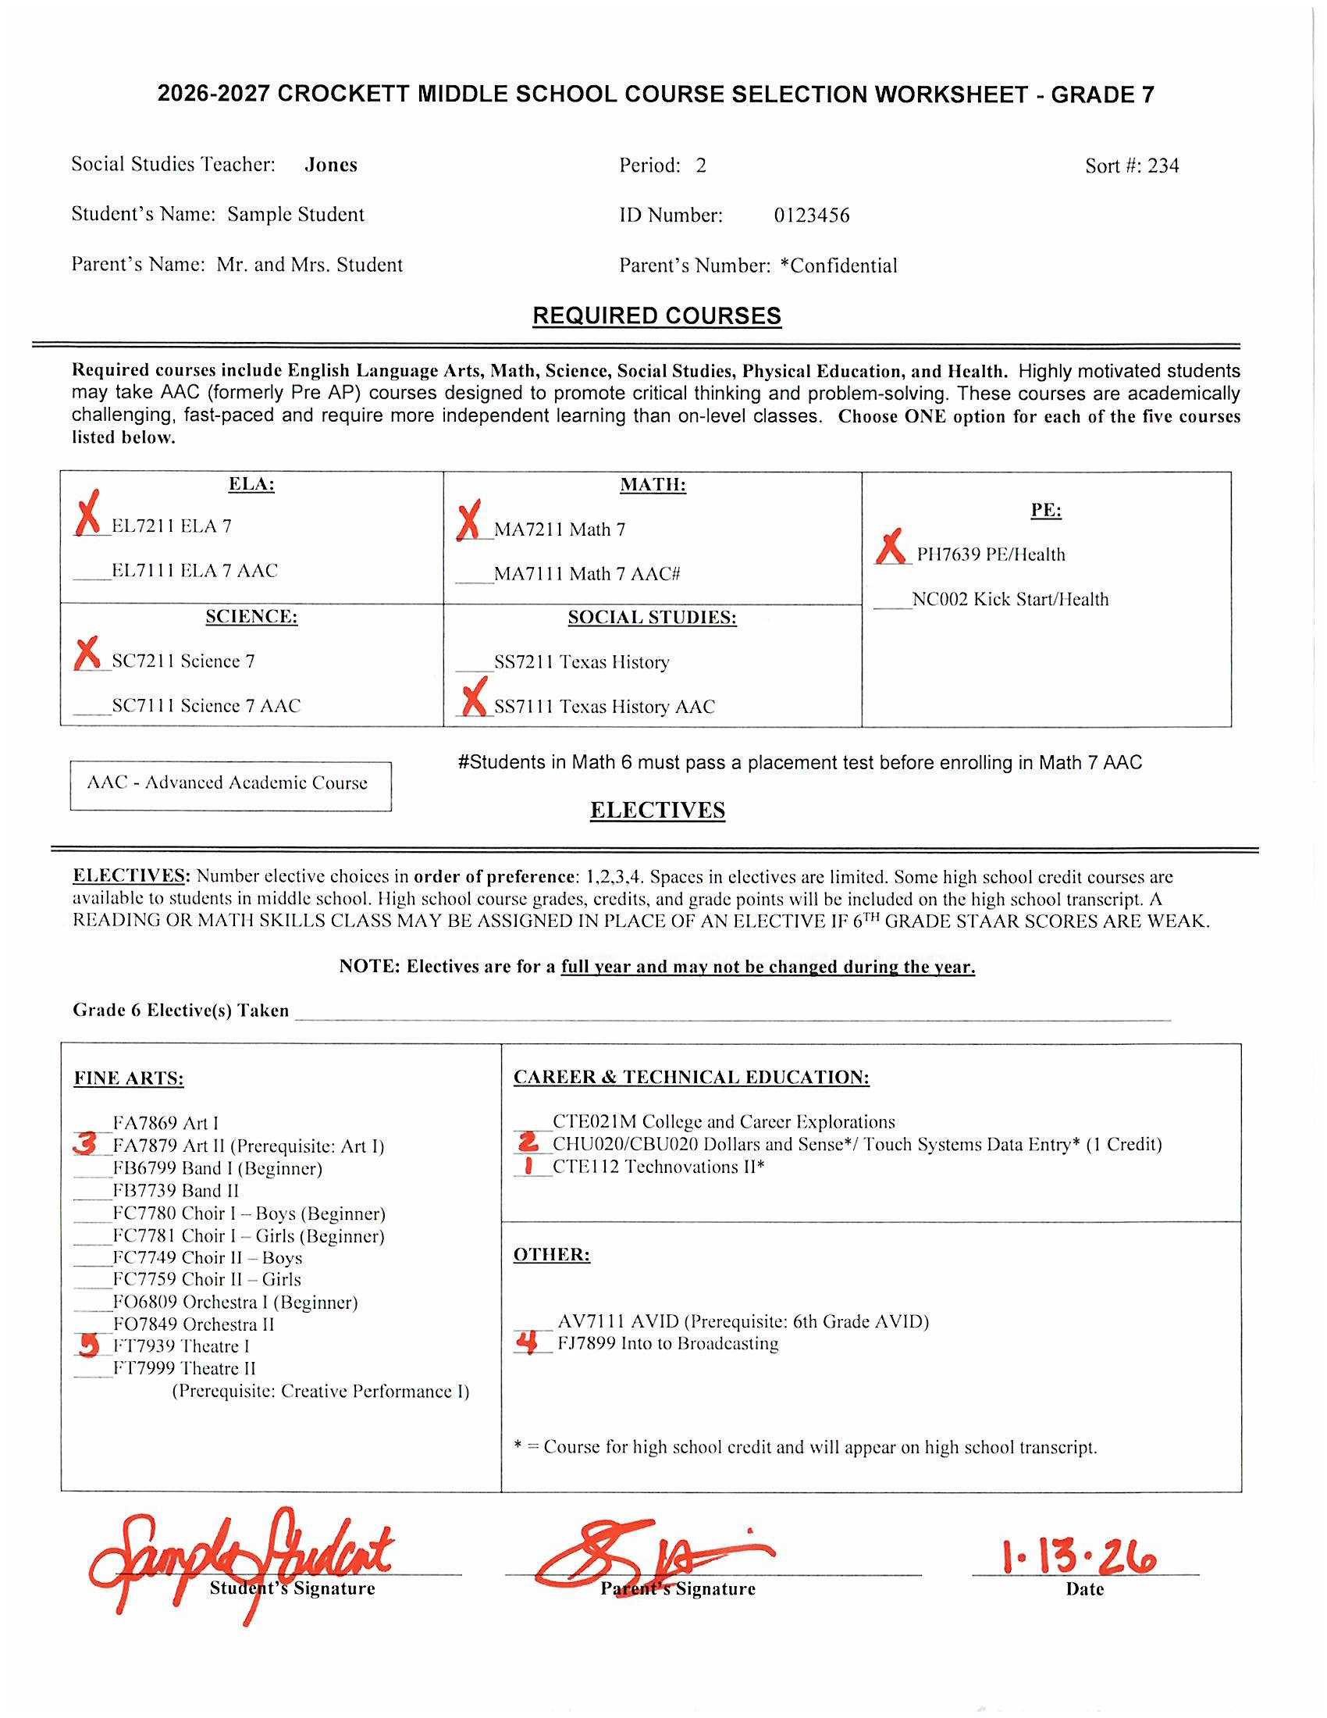

Sample of a Completed Course Selection Sheet

Slide 28
8th Grade
Course Selection

Slide 29
Required Courses for 8th Grade
English On-Level or AAC
U. S. History On-Level or AAC
Math or Algebra 1 On-Level or AAC
Science On-Level or AAC
P.E. OR Intro to Dance OR KickStart
Advisory

Slide 30
Is an AAC Class Right for My Child?
Advanced Academic Curriculum (AAC) courses add depth and rigor.
AAC courses are demanding of time.
The pacing of some AAC courses is very fast. If your child generally picks up new learning quickly, AAC may be a good fit. If your child generally needs a few interventions before picking up new material, a non- AAC course may be more appropriate for them.

Slide 31
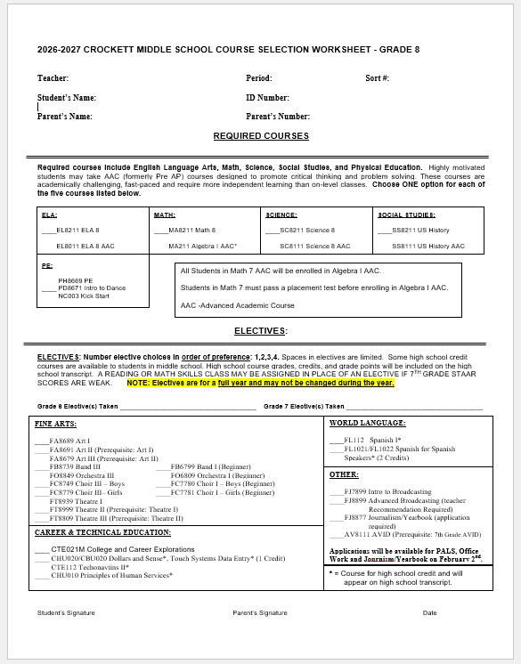
8th Grade Course Selection Form

Slide 32
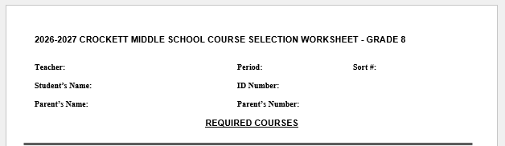
Demographic Information

Slide 33
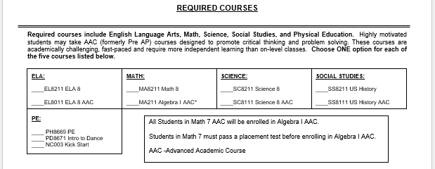
Required Courses
Algebra I is a course for high school credit.
**Please note: If your student is interested in taking Algebra 1 but is not currently in 7th grade AAC math they must take and pass a credit by exam for 8th grade math to be registered for the course. Additional details about registration will come after spring break.

Slide 34
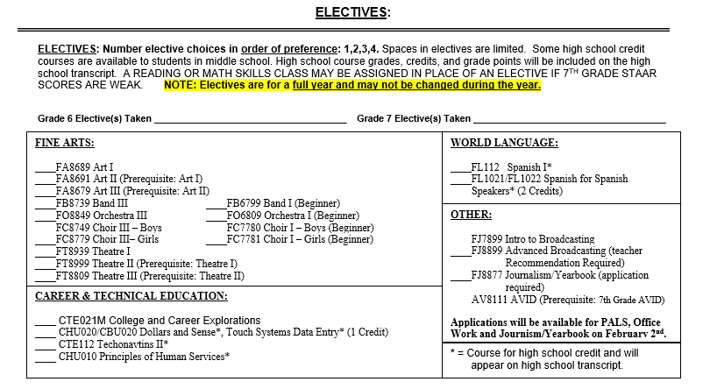
Electives
Number elective choices in order of preference: 1,2,3,4,5

Slide 35
Student and Parent Signatures are required.

Slide 36
Additional Electives

Slide 37
Intro to Broadcasting 8
An introduction to basic graphic design elements for digital media, along with video and audio production techniques will be applied to various project-based learning. Students will be introduced to creating, editing, and directing videos for school-wide communications.

Slide 38
Advanced Broadcasting 8
This course teaches graphic design elements for digital media, along with video and audio production techniques in various project-based learning. This course will produce an in-school video/audio communication program.

Slide 39
Journalism
  This course provides students the opportunity to learn skills necessary for school newspaper production and/or yearbook production, journalistic writing, editing, illustration, layout, distribution, and sales. A school newspaper/yearbook is produced by students in the class.

Slide 40
Career and College Exploration
  The goal of Career and College Exploration is to help students build career awareness and engage in deep exploration and study of the Texas CTE career clusters to create a foundation for success in high school, possible post secondary studies, and careers. The career development process is unique to every person and evolves throughout one’s life. In Career and College Exploration, students use decision-making and problem-solving skills for individual career and academic planning. Students explore valid, reliable educational and career information to learn more about themselves and their interests and abilities. Students integrate skills from academic subjects, information technology, and interpersonal communication to make informed decisions. This course is designed to guide students through the process of investigating and developing a college and career readiness plan. Students use aptitude and interest inventory assessments, labor market information, software, or other tools available to explore a variety of career paths, especially those in demand. Students will begin mapping their anticipated secondary coursework and potential postsecondary experiences that are in alignment with their Goals.

Slide 41
Electives for High School Credit
**HS credit courses remain on your student’s high school transcript and count toward your student HS Grade Point Average (GPA)**

Slide 42
Fundamentals of Computer Science
(1 credit)
  Fundamentals of Computer Science will foster student creativity and innovation by presenting opportunities to design, implement, and present solutions to real-world problems. Students will collaborate and use computer science concepts to access, analyze, and evaluate information needed to solve problems. Students will work with HTML, Scratch, Python, or JavaScript programming languages. Participation in this course satisfies the level one course requirement of the Programming and Software Development Pathway in the STEM program area.

Slide 43
Spanish I
(1 credit)
  The goal of the study of the beginning levels of modern languages is communicative competence in authentic, real-world situations. Students in this course will develop novice-mid to novice-high proficiency in speaking, listening, reading, and writing on topics dealing with people, places, and events they are likely to encounter in everyday life. The cultural products, practices, and perspectives of the target culture(s) are integrated into all aspects of the course. This course is conducted in the target language as much as possible.

Slide 44
Spanish for Spanish Speakers
(1 credit per semester)
Students who are heritage or native speakers of Spanish may receive credit for Spanish I and II upon successful completion of this course in one year. The main objective of this course is to help heritage or native speakers of Spanish to become fully bilingual and biliterate so that they can benefit from this skill in the workforce in the future. The focus of this course is to increase students’ proficiency level in all three modes of communication, recognizing that the needs of heritage and native speakers are different from those of non-native and non-heritage students of Spanish. Students are expected to achieve a minimum of intermediate-mid proficiency level by the end of this course, depending upon their beginning level.

Slide 45
*Foreign Language Credit By Exam*
  Credit by examination is a way to earn high school credit without taking the class. The exam assesses reading, writing and language proficiency in languages other than English. Students who take the exam may earn up to four World Languages credits.

Slide 46
Dollars and Sense
(.5 credit)
  Dollars and Sense focuses on consumer practices and responsibilities, money-management processes, decision making skills, and impact of technology. The student demonstrates management of individual and family resources such as finances, food, clothing, shelter, health care, recreation, transportation, time, and human Capital.

Slide 47
Touch Systems Data Entry
(.5 credit)
This course will allow students to develop keyboarding skills and techniques. Students will use software applications to develop and format basic business documents as well as enhance reading, writing, computing, and communication skills applicable to a variety of industries.

Slide 48
Technovations II
(1 Credit)
This course will dive deeper into more complex and practical robotics applications while introducing aviation and more advanced coding. Students will apply their engineering skills to design and program more advanced robots for real-world scenarios. They will explore the core principles of flight, aerodynamics, and elementary drone design.

Slide 49
Principles of Human Services
(1 credit)
Students will investigate different careers that involve helping and serving people. This course provides hands-on experience in the career fields of counseling and mental health, early childhood development, family and community services, fashion and interior design, and entrepreneurial pathways. Students will also develop strong career traits in management, budgetary practices, and nutrition.

Slide 50
Specialized Middle School Programs
*Application Required*

Slide 51
Peer Assistance and Leadership (PALS)
  Students learn and develop leadership skills in goal setting, communication, peer listening, group dynamics, project planning, and implementation. Students also investigate techniques and skills needed to provide programs to their peers that increase motivation, self-esteem, and student Involvement. Application Only.

Slide 52
Office Worker
Students who have strong academic grades, good conduct, and a teacher’s recommendation may take Office Work. Students perform routine office assignments, such as answering the phone and delivering messages. Application only.

Slide 53
8th Grade AVID
  The eighth-grade AVID Elective course is the year of preparation for high school. Students will refine previous goals, focusing on their transition to high school as part of a college preparatory path. Their writing will focus on completing all steps of the writing process and varying style, word choice, vocabulary, structure, and voice. Other areas of focus include increasing the use of technology, building upon their test preparation and test-taking knowledge, analyzing text, and utilizing appropriate reading strategies in various settings. Students will become more involved in the presentations of guest speakers and field Trips. Application Only.

Slide 54
Physical Education Alternative

Slide 55
Introduction to Dance
The purpose of this course is to explore the fundamentals of movement. Aerobic fitness dance, recreational dance, and dance forms including ballet, folk/ ethnic, jazz, tap, precision, hip hop, lyrical, and modern that will challenge the students to employ both fine and gross motor skills. Students receive a brief historical overview of dance.

Slide 56
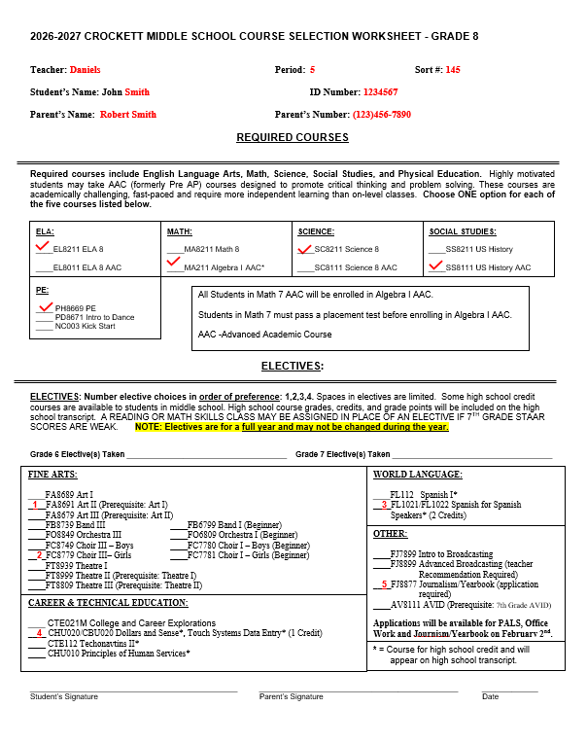
Sample of a Completed Course Selection Sheet

Slide 57
Reminders
Please be sure students turn in their completed & signed course selection sheets to their Texas History teachers by Friday, January 23rd
  No signed course selection sheet = No SchooLinks input
Course guides and other course selection information is posted on the DCMS Counselor Website and in your student’s Counselor’s Schoology page
AVID Applications are available online on the district AVID home page
  Deadline for applications is 1/29/26
  For more information, contact the AVID teacher Mr. Thomas @ clifford.thomas@fortbendisd.gov

Slide 58
Contact Information
Ms. Anitra Moore, 6th Grade Counselor
  Anitra.Moore@fortbendisd.gov
  281-634-6430
Mr. Daniels, 7th Grade Counselor
  Clayton.Daniels@fortbendisd.gov
  281-634-6459

